Slide 1
Options Payoff Visualization Tool
Associate Quant Presentation
Vivaan Gupta, Grant Simon, and Dylan Terayama April 2025

Slide 2
Agenda
Payoff Tool Presentation
Why Visualize
2. Calls/Puts
3. Option Greeks
4. Option Strategy & Code
5. Improvements & Limitations

Slide 3
Introduction & Objective
Payoff Tool Presentation
Overview
Options are financial derivatives that give the buyer the right, but not the obligation, to buy or sell an underlying asset at an agreed-upon price in the future.
Types:
Call
Put
Allow for investors to hedge portfolios
Objective:
Develop a Python tool that takes options parameters for common strategies and generates a payoff diagram at expiration.

Slide 4
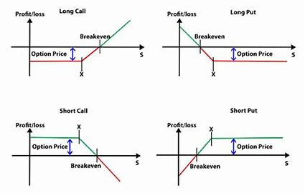
The Importance of Visualization
Payoff Tool Presentation
Reasoning
Option strategy is complicated and has multiple moving parts
Offers strategic flexibility
Helps when hedging risk
Element of leverage
Visuals summarize complex information and shows the bigger picture
Helpful when communicating with others or testing ideas
Fundamental Input Parameters
Underlying price: The current market price (or a range of prices) of the asset on which the option is based.
Strike price: The price at which the option can be exercised.
Premium: The cost of buying or the proceeds from selling the option contract.
Position: Indicates whether the option is held long or short.
Notes:
Options are complex financial instruments that can provide leverage, hedge downside risk, and offer strategic flexibility. However, when using more advanced strategies like spreads or multi-legged combinations, it can be difficult to fully understand the risk and reward profile just by looking at an options chain.
Visualization bridges that gap. Payoff diagrams and other visual tools clearly display where break-even points are, where profits start accumulating, and where exposure to losses increases. Instead of piecing together multiple premiums, strike prices, and expiration dates in your head, visualization lays it all out in one, easy-to-read graph.
Historically, options traders on the floor relied on visualization to adjust positions quickly as market conditions shifted. Real-time access to how different price movements impacted their portfolio allowed them to execute trades with precision. Today, in quantitative finance, visualization is just as critical — allowing us to simulate, prototype, and optimize strategies with greater clarity. Without it, spotting key weaknesses or opportunities in a strategy becomes much harder, and decision-making slows down.

Slide 5
Libraries Used
Payoff Tool Presentation
NumPy
Matplotlib
Option Math Speeds up payoff calculations by applying formulas across arrays of prices instead of using loops.
np.maximum() Used to ensures certain option payoffs don’t go negative as intrinsic value can’t go below zero. This reflects real-world logic where an out-of-the-money option isn’t exercised, meaning its intrinsic value is zero, not negative.
np.linspace() Used to create evenly spaced prices (70%–130% of current price) to simulate how strategies perform across different scenarios.
Draws Option Payoff Charts
Shows how much money you could make or lose at different prices when your option expires.
Easy to Customize:
You can add titles, labels, lines for strike price or break-even, and a legend to make the chart clearer.
Works Well with NumPy:
You can plug in NumPy data (like prices and payoffs) directly into the plot.

Slide 6
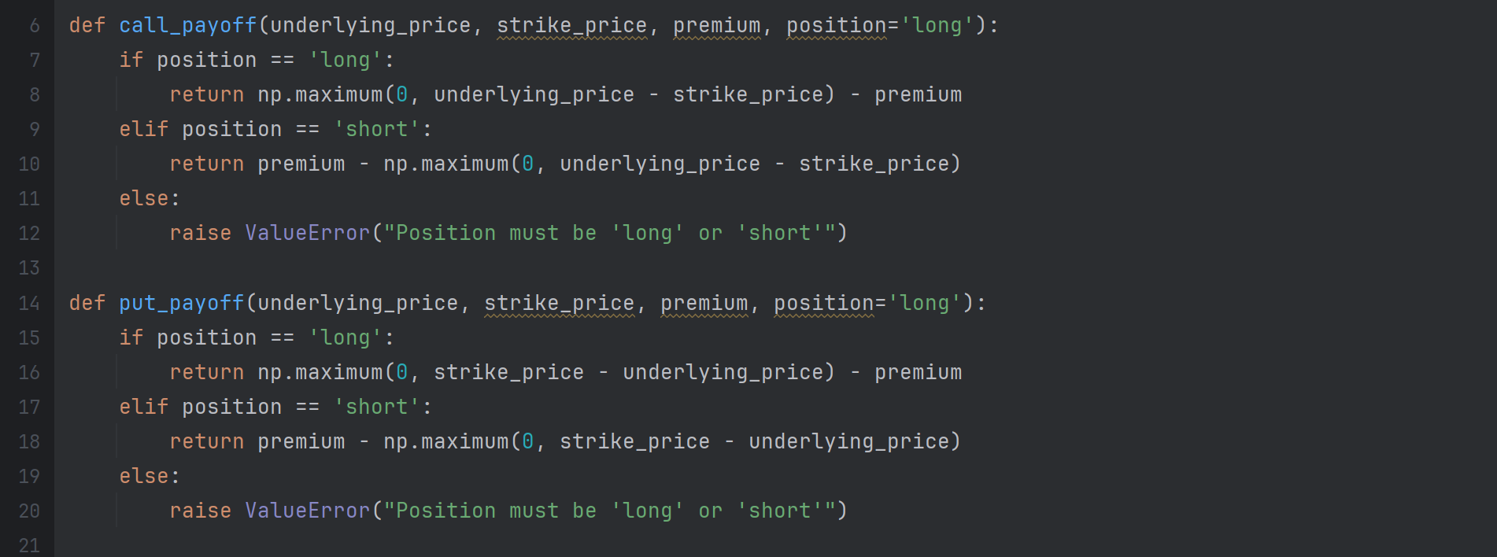
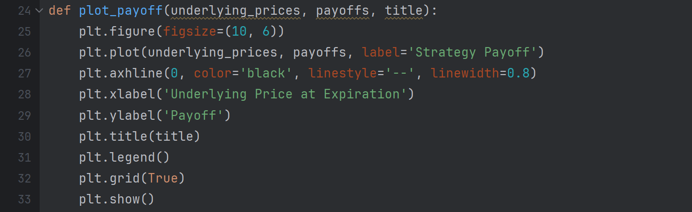
Code for Calls/Puts
Payoff Tool Presentation
"call_payoff"
Calculates call option payoff for long or short positions using np.maximum().
Validates position and raises an error for invalid inputs.
"put_payoff"
Calculates put option payoff for long or short positions using np.maximum().
Validates position and raises an error for invalid inputs.
"plot_payoff"
Inputs: underlying_prices, payoffs, and a plot title
Plots payoff vs. price with labels, title, legend, and grid
Adds horizontal line at 0 to show breakeven point
Notes:
strike_price - underlying_price: This calculates the intrinsic value of the put at expiration. If the strike price is higher than the underlying price, this value is positive (the option is "in the money" - the buyer could buy the asset at the lower market price and then sell it at the higher strike price). If the strike price is lower than or equal to the underlying price, the intrinsic value is zero or negative.

Slide 7
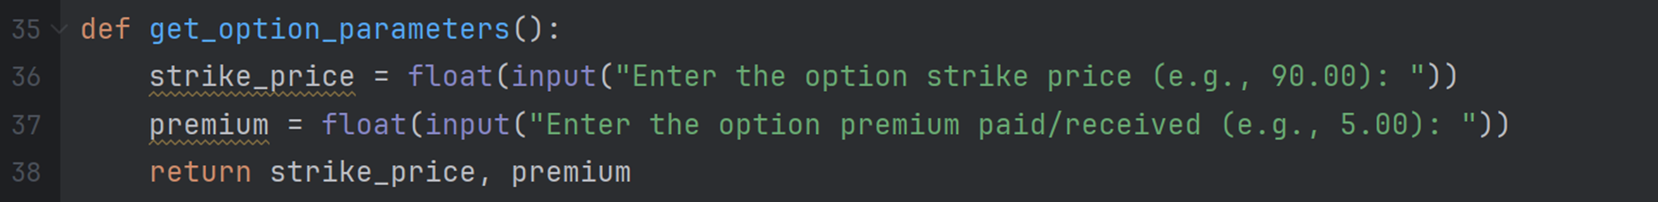
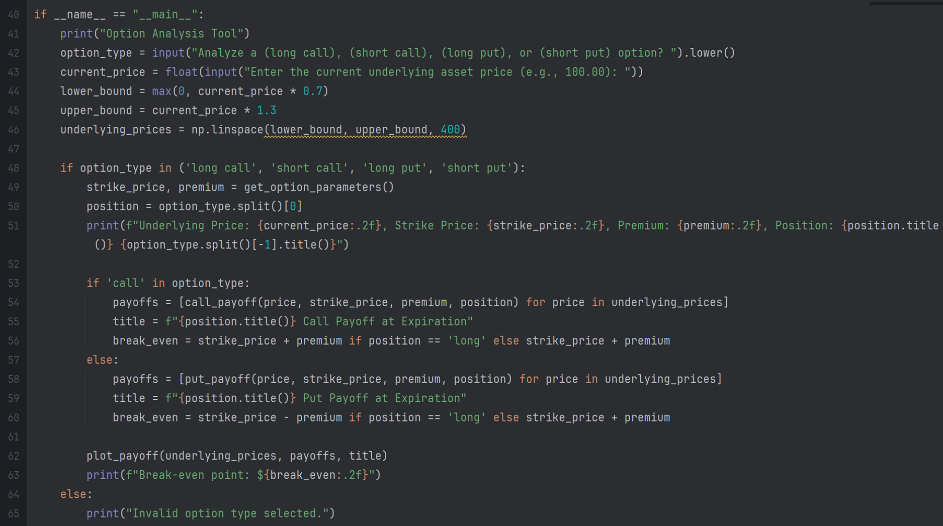
Code for Calls/Puts
Payoff Tool Presentation
"get_option_parameters"
get_option_parameters() collects option details from the user
Prompts for strike_price and premium using input()
Converts inputs to numbers using float()
Returns both values as a tuple for later use
Setup & User Input
Prompts for option type and current price
Generates 400 price points (70%-130% of current) using numpy.linspace
Validates option type and gathers strike price/premium
Payoff Calculation
Checks if option is 'call' or 'put'
Calculates payoffs using call_payoff() or put_payoff()
Sets title, calculates break-even point
Displays payoff chart with plot_payoff()

Slide 8
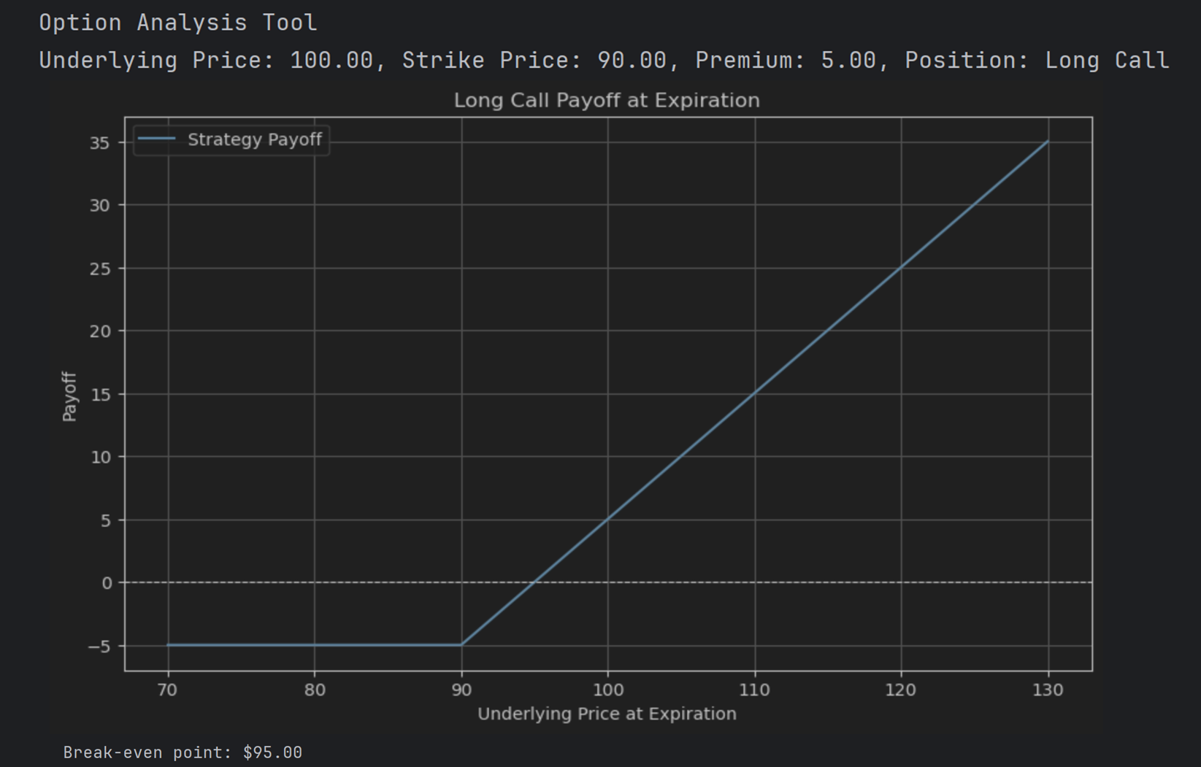
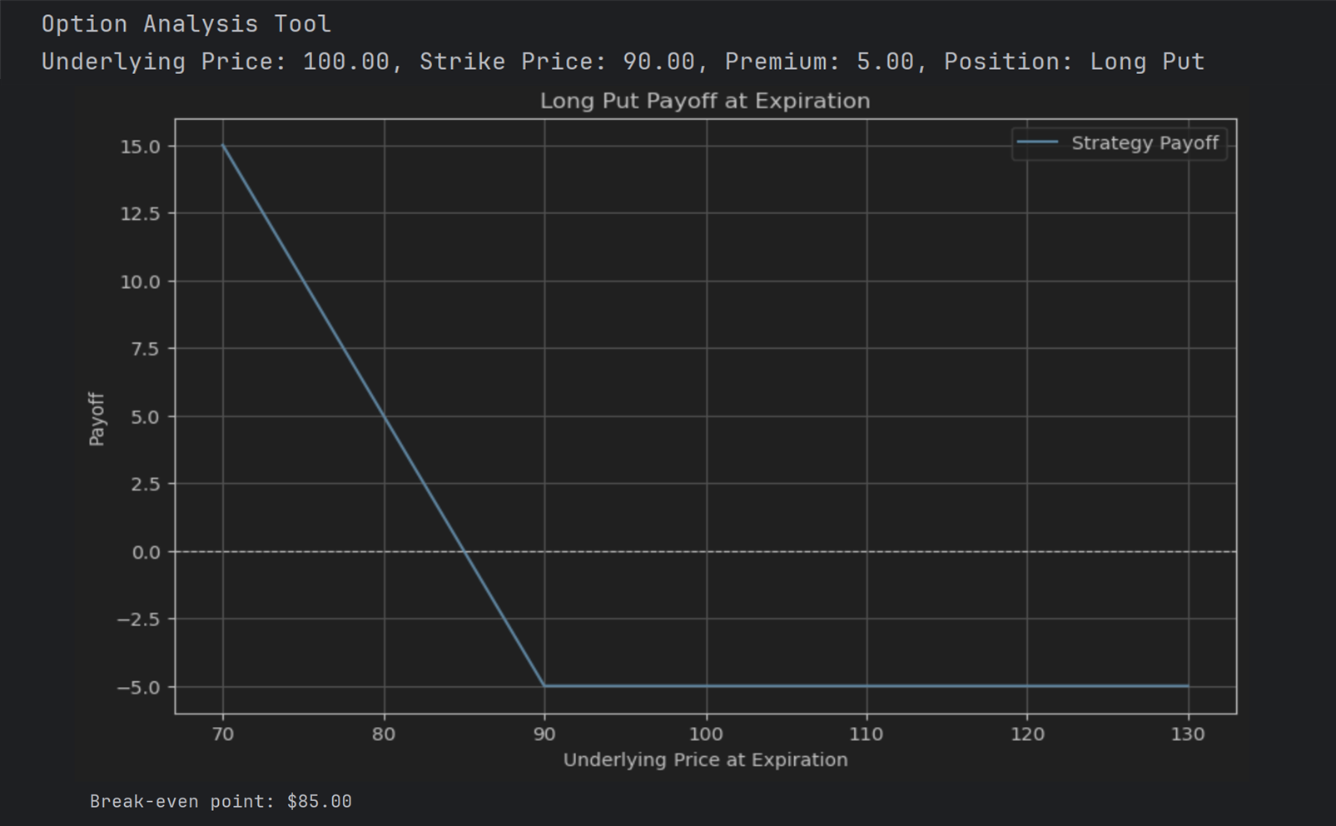
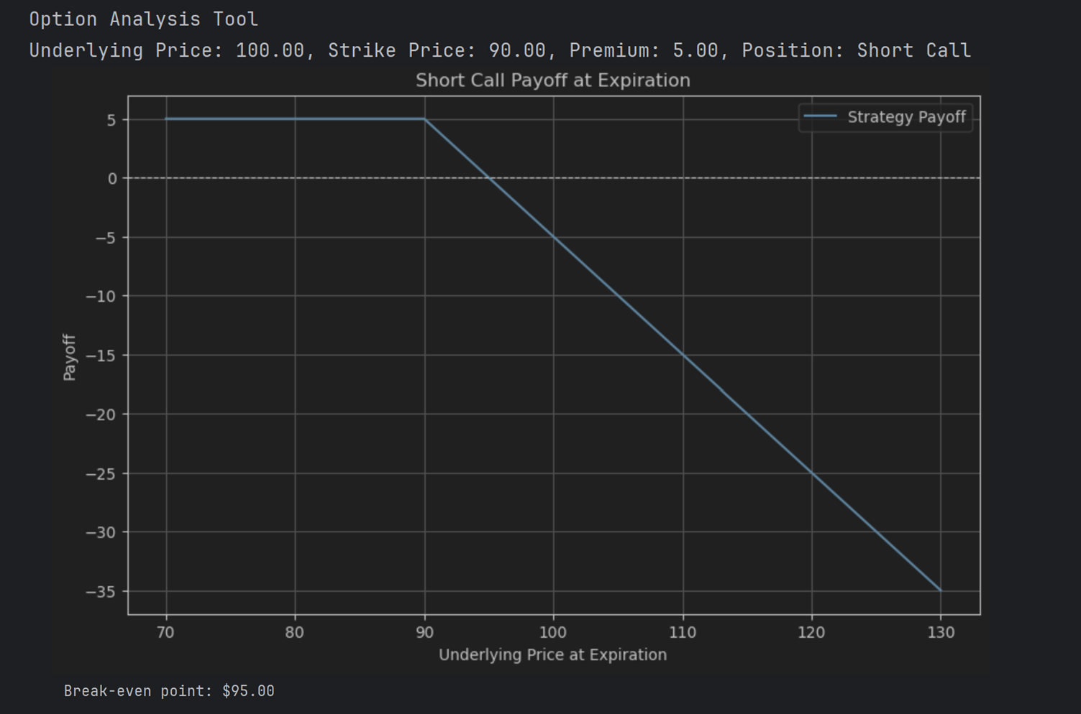
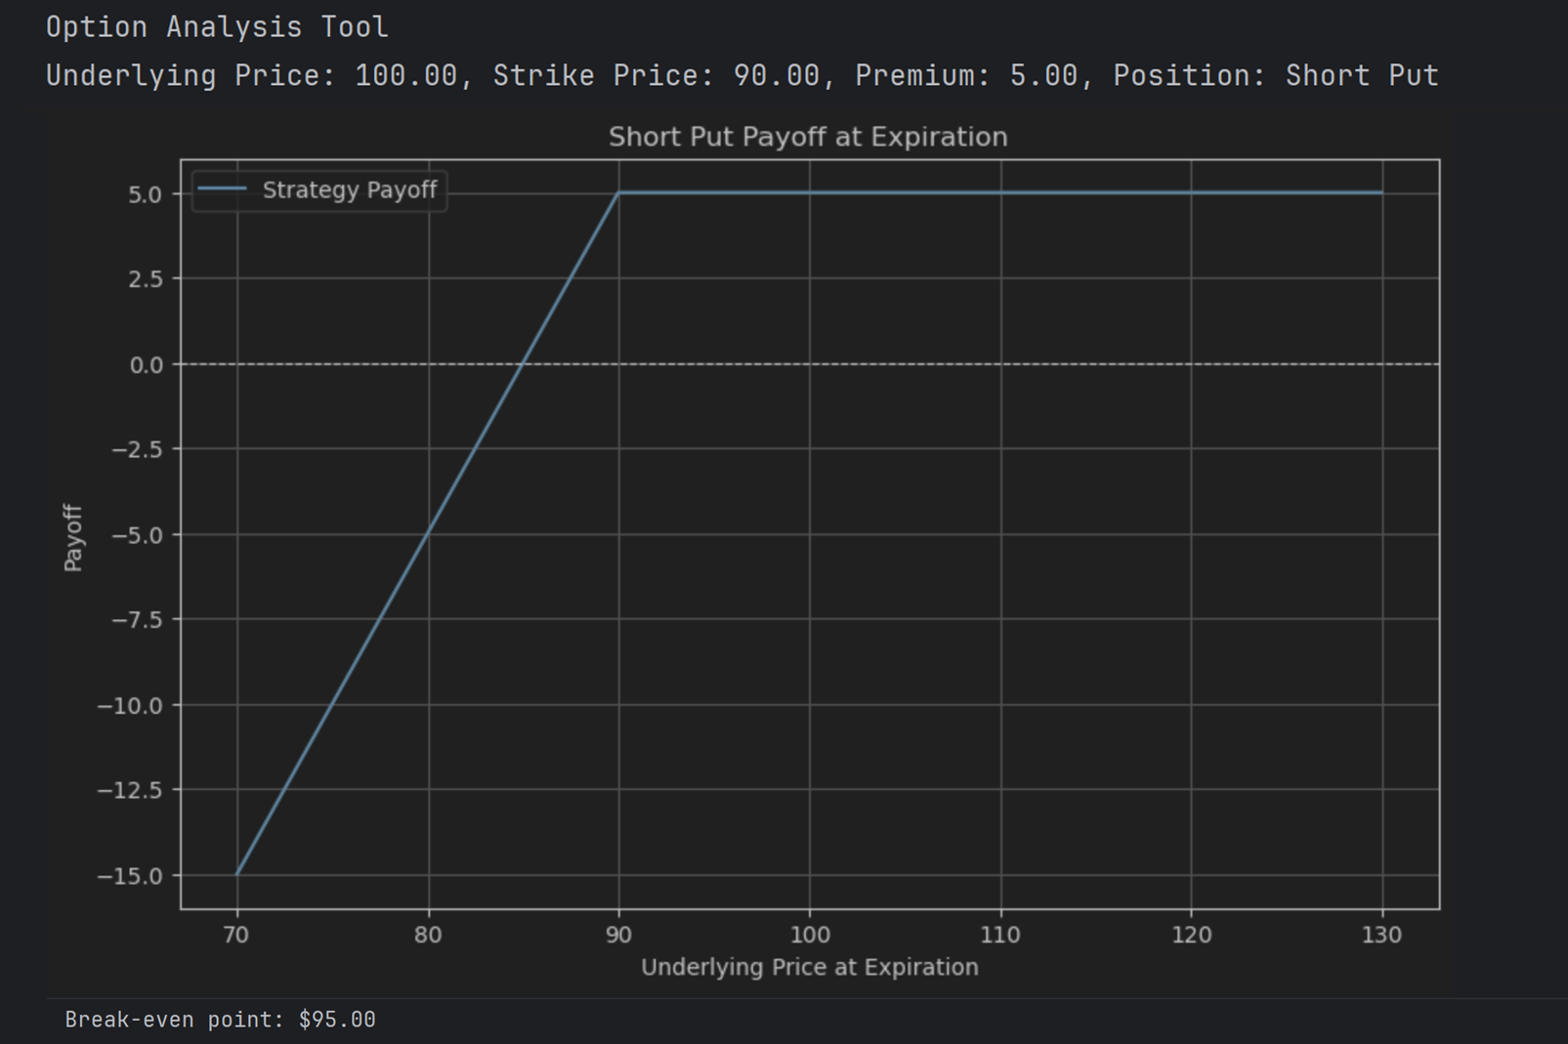
Output
Payoff Tool Presentation

Slide 9
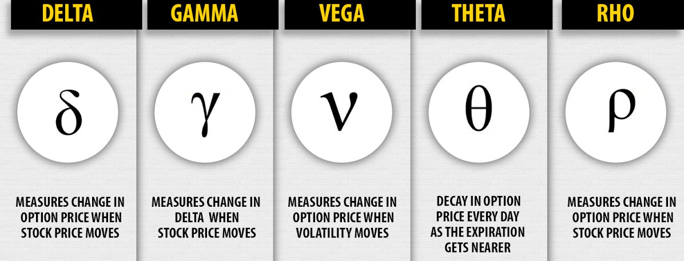
Option Greeks
Payoff Tool Presentation
5 Factors:
Notes:
Understanding the Greeks and implied volatility (IV) is fundamental to navigating options trading successfully. Each Greek measures a different type of risk sensitivity, helping traders anticipate how option prices will react under changing market conditions.
Delta measures how much an option’s price is expected to move relative to changes in the underlying asset’s price. Gamma measures how quickly Delta itself changes as the underlying moves, helping traders manage their position’s sensitivity more accurately. Theta measures time decay — the loss of value as the option nears expiration — which can work against long option holders over time. Vega tracks how an option’s price changes relative to shifts in implied volatility, a key driver of option premiums that can boost or erode position value even if the underlying price remains steady.
Implied volatility (IV) is especially important because it reflects the market's expectations for future volatility. In strategies like the straddle, IV plays a crucial role. A rise in IV can enhance the value of both calls and puts, even without a movement in the underlying asset. On the trading floor, clerks and traders carefully monitored volatility, knowing that shifts in IV could change the profitability of a trade faster than price movements alone. Today, with faster, automated markets, tracking volatility remains a cornerstone of effective options trading.

Slide 10
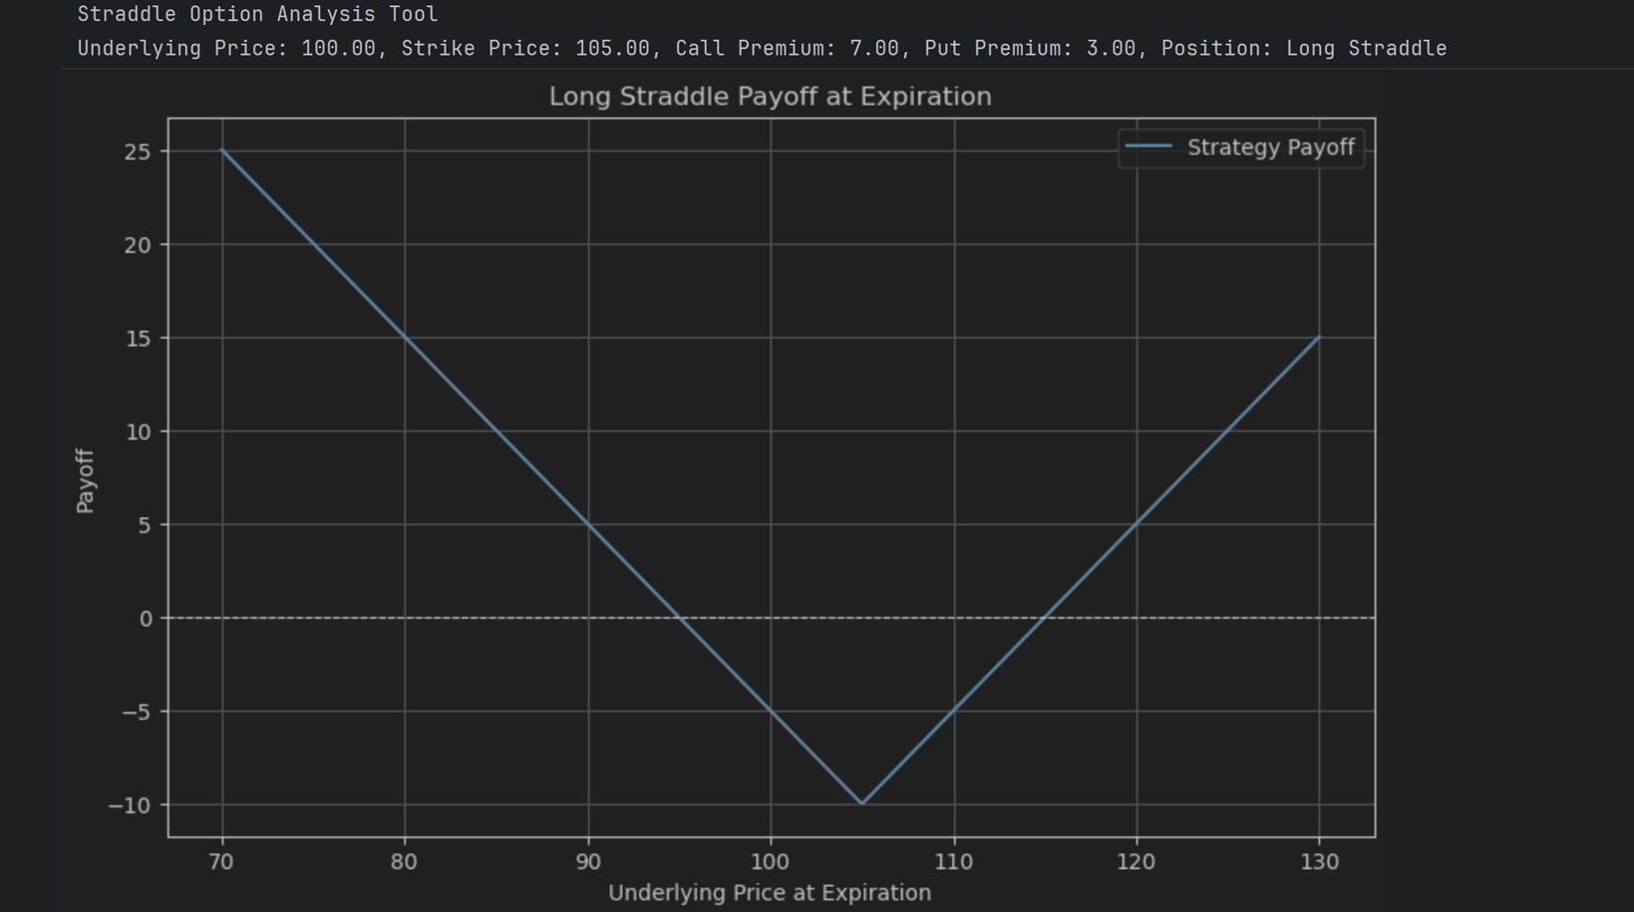
Long Straddle
Payoff Tool Presentation
Description
Strategy: purchase long call and long put with the same expiration date and strike price, monitor the position and finally exit both legs
Unlimited upside potential
Max loss = both premiums paid
Theta decay hurts position over time
Benefits at higher IV levels
Notes:
The straddle is a classic market-neutral strategy designed to profit from significant price movement, regardless of direction. It involves buying both a call and a put option at the same strike price and expiration date, giving the trader the ability to benefit if the underlying asset moves sharply up or down.
The payoff structure of a straddle forms a “V” shape. The trader’s maximum loss is limited to the combined premiums paid for the call and put, while potential profits are theoretically unlimited if the underlying asset moves far enough in either direction. The further the price moves from the original strike price, the larger the potential gain.
However, straddles come with important considerations. Time decay works against the position daily, meaning Theta plays a significant role in the strategy's performance. Additionally, implied volatility heavily influences the profitability of a straddle. A rise in IV after entering the position can significantly boost its value, while a fall can erode gains, even if the price moves as expected. Successfully managing a straddle involves balancing the expectation of volatility with an understanding of how time and price shifts affect the overall position.

Slide 11
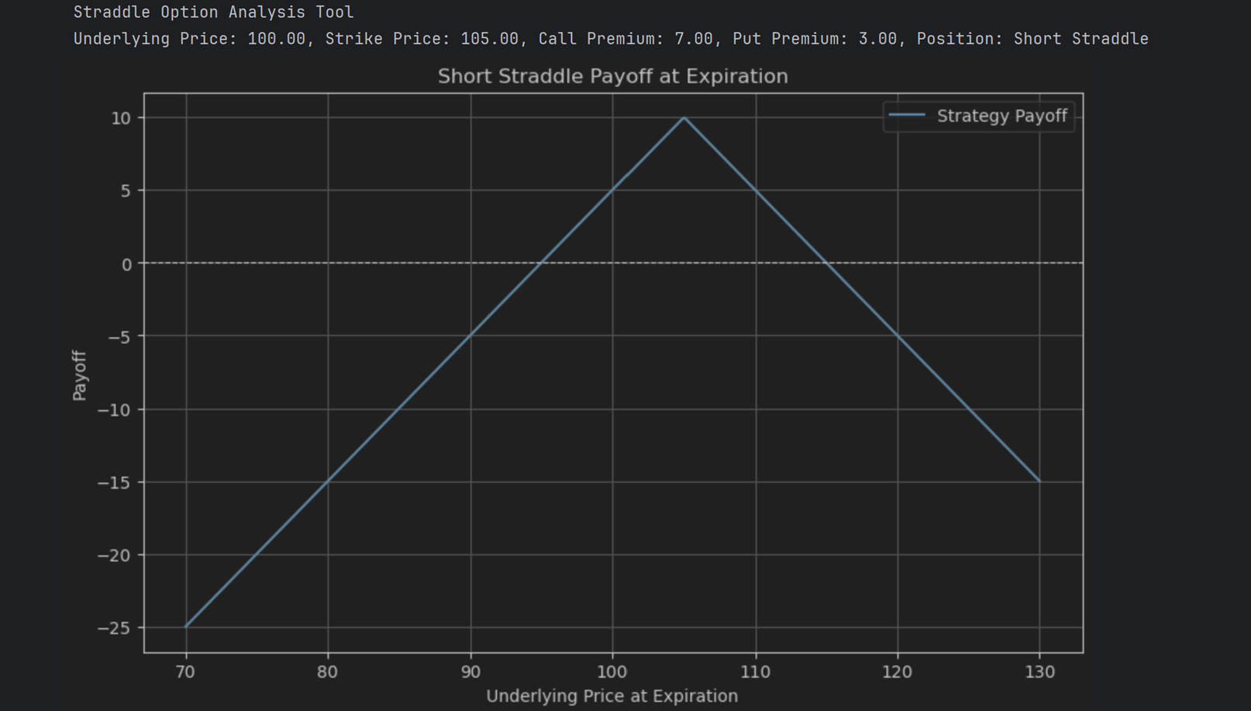
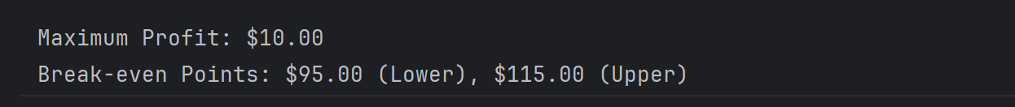
Short Straddle
Payoff Tool Presentation
Description
Sell a call and a put with the same strike price and expiration
Used when expecting low volatility and little price movement
Max profit is the total premium received
Max profit occurs if the stock finishes at the strike price
Losses are unlimited if the stock rises sharply
Significant losses if the stock drops sharply
Breakevens: strike price ± total premium received
High risk, limited reward
Requires substantial margin due to risk
Notes:
The straddle is a classic market-neutral strategy designed to profit from significant price movement, regardless of direction. It involves buying both a call and a put option at the same strike price and expiration date, giving the trader the ability to benefit if the underlying asset moves sharply up or down.
The payoff structure of a straddle forms a “V” shape. The trader’s maximum loss is limited to the combined premiums paid for the call and put, while potential profits are theoretically unlimited if the underlying asset moves far enough in either direction. The further the price moves from the original strike price, the larger the potential gain.
However, straddles come with important considerations. Time decay works against the position daily, meaning Theta plays a significant role in the strategy's performance. Additionally, implied volatility heavily influences the profitability of a straddle. A rise in IV after entering the position can significantly boost its value, while a fall can erode gains, even if the price moves as expected. Successfully managing a straddle involves balancing the expectation of volatility with an understanding of how time and price shifts affect the overall position.

Slide 12
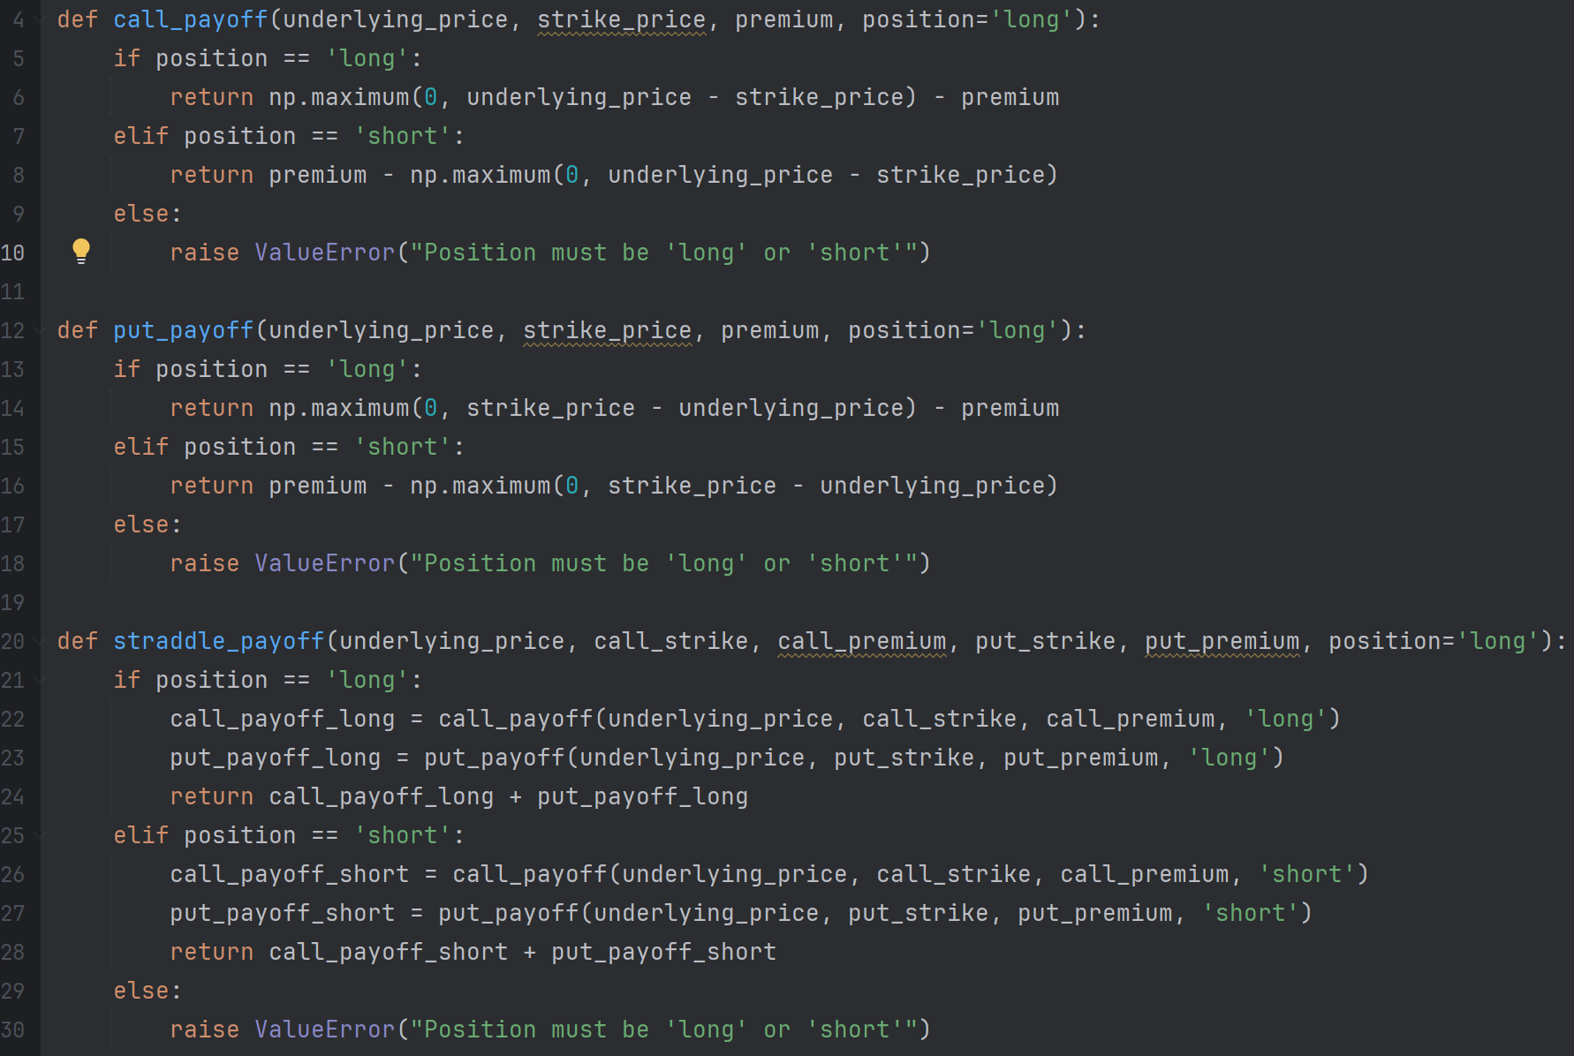
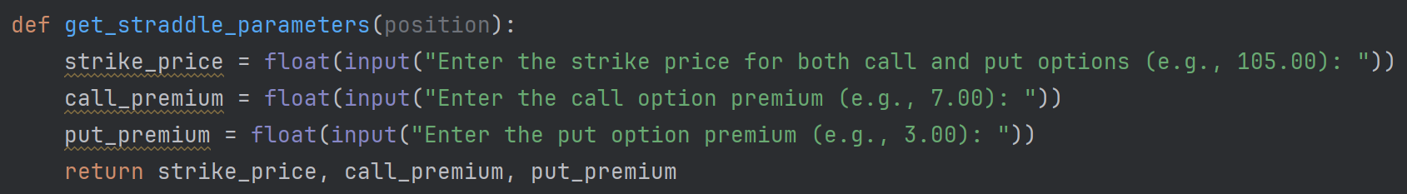
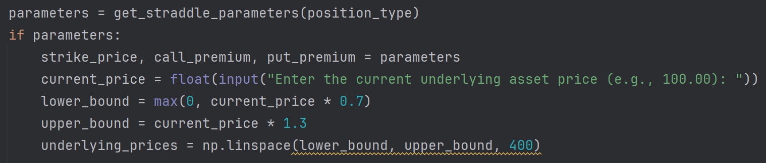
Code for Straddle
Payoff Tool Presentation
"straddle_payoff"
Calculates the total profit or loss of a long or short straddle by summing the call and put payoffs based on the position type.
"get_straddle_parameters"
Prompts the user for the strike price and premiums of call and put options, then returns these values as parameters.
Setting Up Price Range
Uses NumPy to ensure non-zero intrinsic value and generate a range of underlying prices based on user-defined parameters.
Notes:
Te t

Slide 13
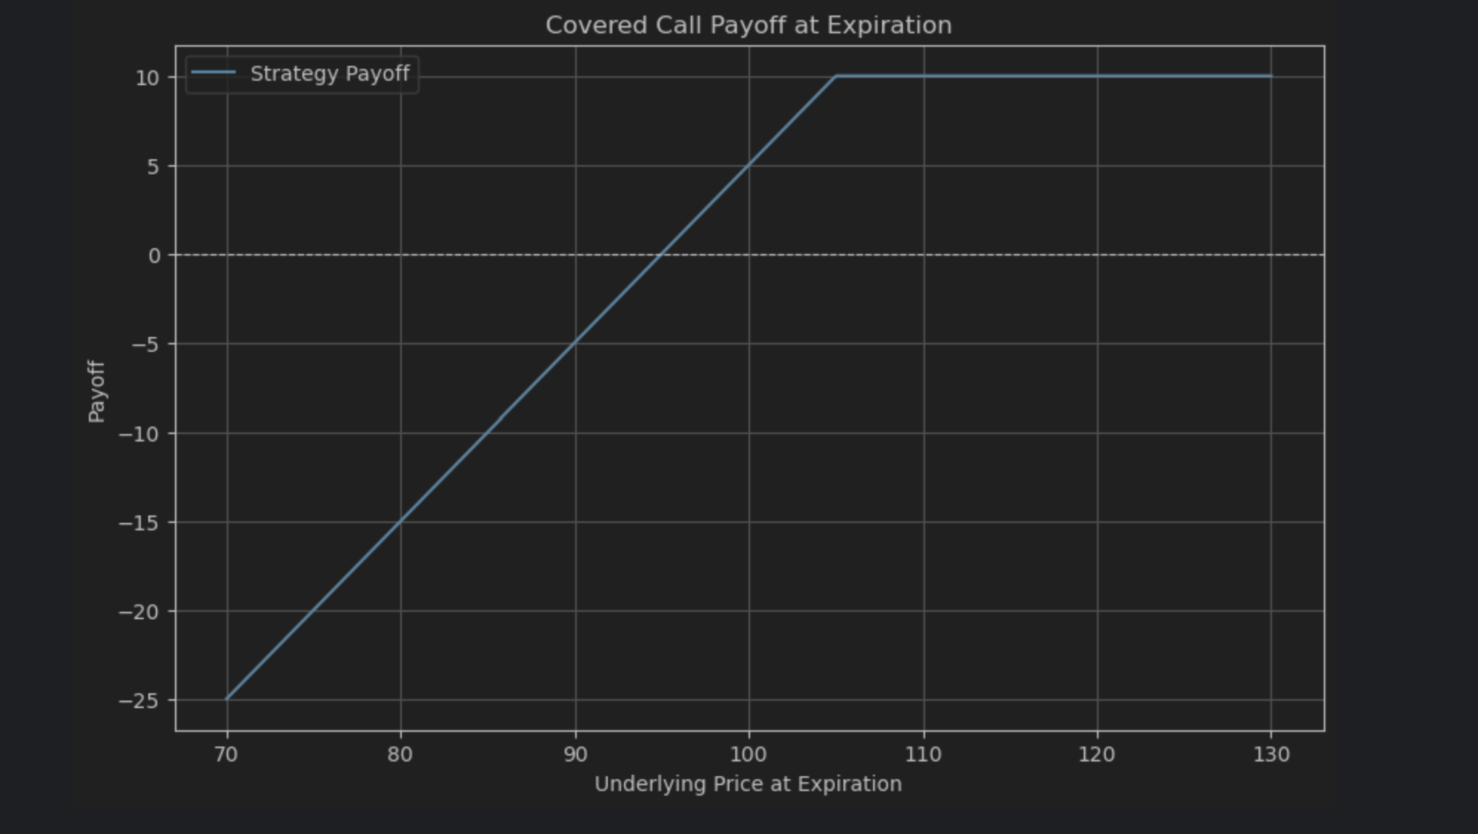
Covered Call
Payoff Tool Presentation
Description
Selling a call option
Collect premium while limiting upside
Best if neutral or slightly bullish
Cash from premium and protects the downside slightly
Miss out on high profits if price surges – unlimited downside
Low risk if stock tanks
Can mitigate risk by owning the underlying asset

Slide 14
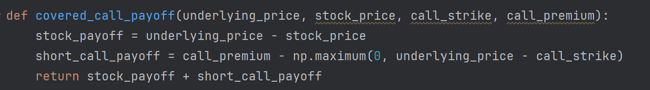
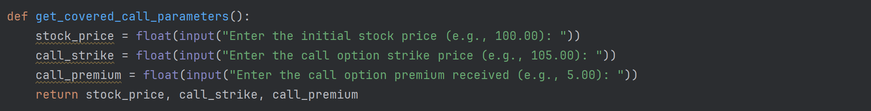
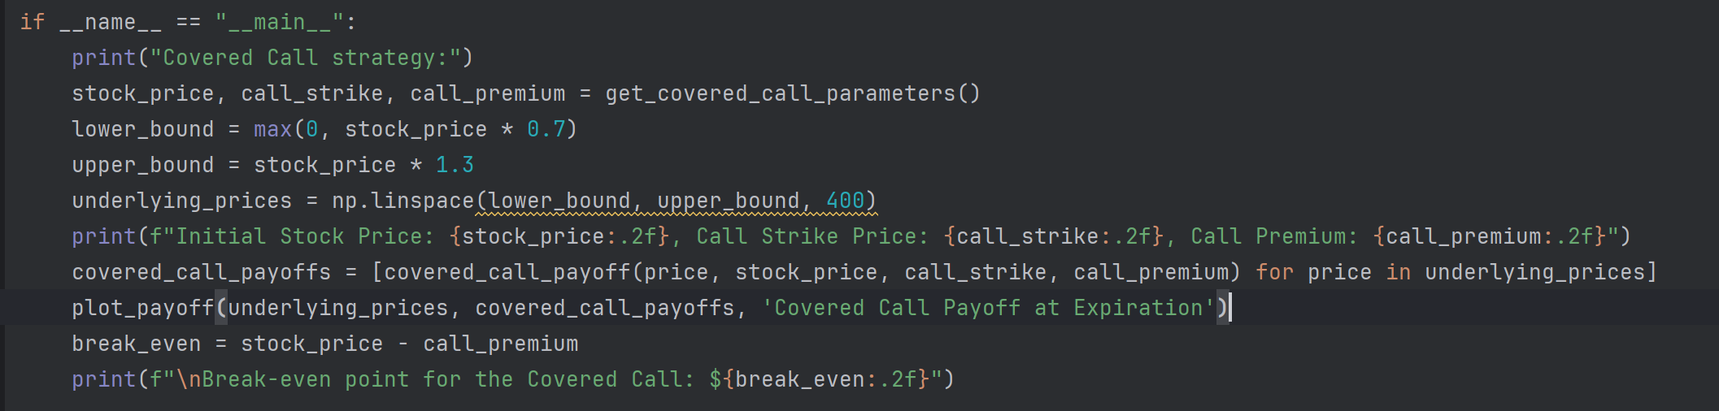
Covered Call Code
Payoff Tool Presentation
"covered_call_payoff"
Calculates the net payoff of a covered call strategy by combining stock value change and short call payoff.
"get_covered_call_parameters"
Retrieves user-defined parameters for the covered call strategy, including stock price, call strike price, and call premium.
Calculating and Visualizing Payoff
Executes the covered call strategy, retrieves user parameters, calculates potential payoffs across a range of underlying prices, and plots the payoff.

Slide 15
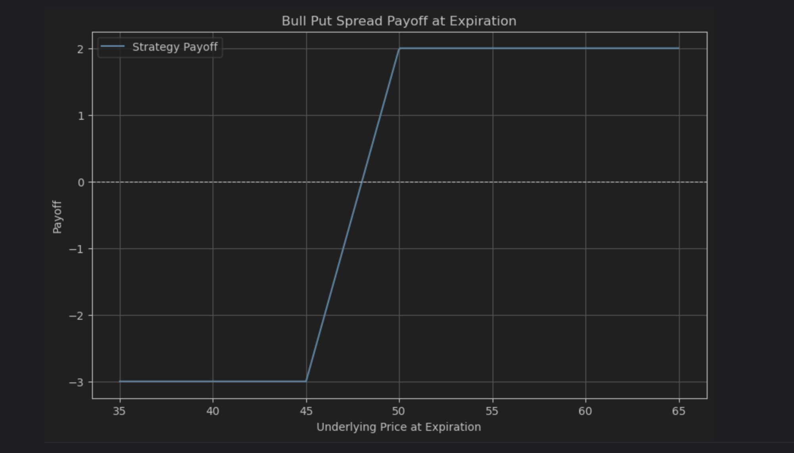
Vertical Spread
Payoff Tool Presentation
Description
Bull call (debit)
Buying a call and selling a call at a higher strike price
Bear call (credit)
Selling a call and buying a call at a higher strike price
Bull put (credit)
Selling a put and buying a put at a lower strike price
Bear put (debit)
Buying a put and selling a put at a lower strike price
Credit maximum loss is the difference in strike prices less net premium, Debit maximum loss is net premium
Reduce premium cost (great during volatile markets)
Hedges risk by taking both sides of a position

Slide 16
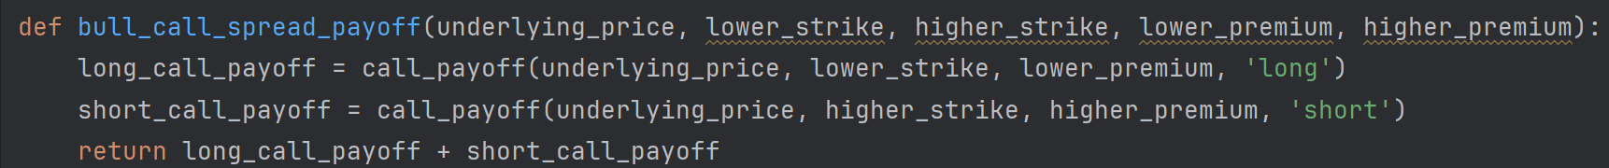
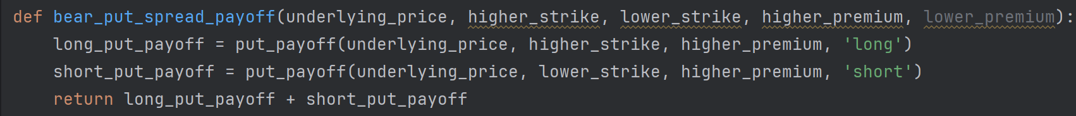
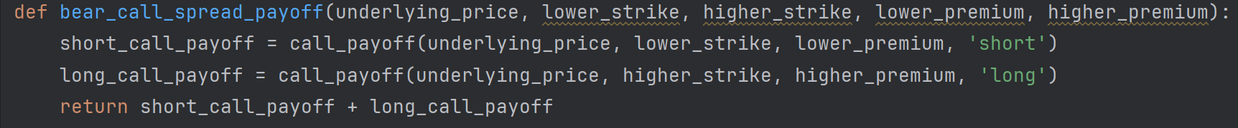
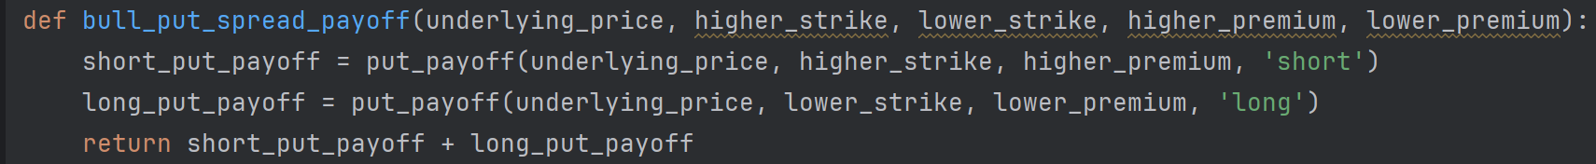
Code for Vertical Spread
Payoff Tool Presentation
Defining Spread Payoff Functions
Defines four functions to calculate net payoffs for vertical spread strategies: bull call, bear put, bear call, and bull put spreads.
Each strategy combines a long and short position on the same option type (call or put) at different strike prices.
Uses call_payoff and put_payoff helper functions to calculate individual leg payoffs, accounting for premiums and option type.
Returns the total strategy payoff at expiration by summing the long and short leg results.

Slide 17
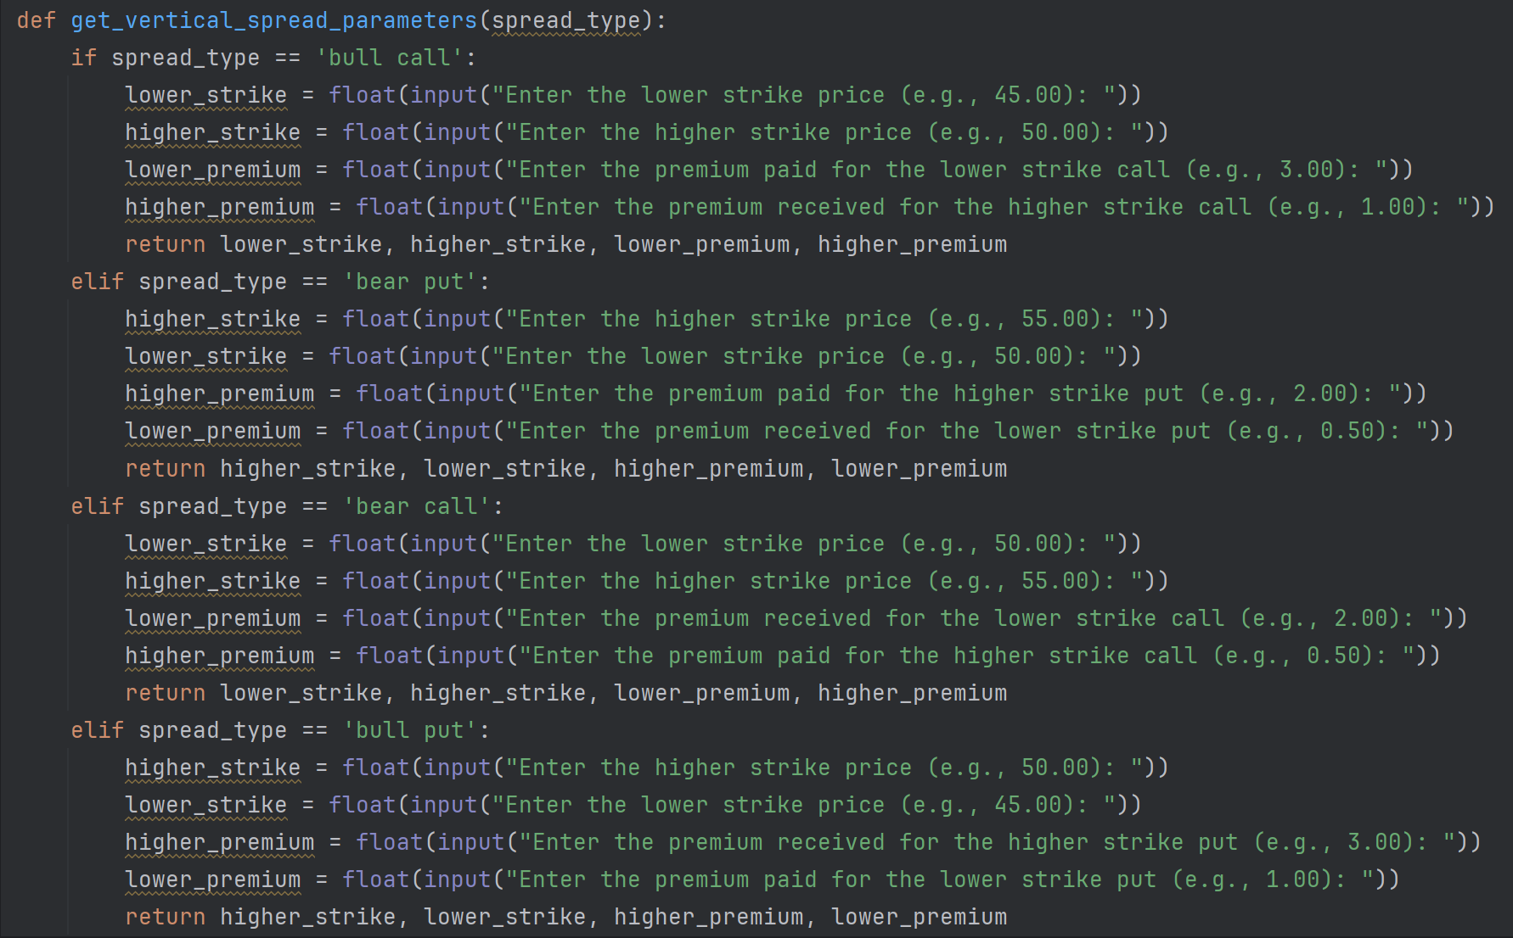
Code for Vertical Spread
Payoff Tool Presentation
"get_vertical_spread_parameters"
Gathers key spread parameters by prompting the user for strike prices and premiums based on the selected strategy
Provides contextual input prompts using if/elif logic tailored to bull call, bear put, bear call, or bull put spreads
Ensures numerical format by converting inputs to floats for accurate calculations
Returns a structured output as a tuple for use in payoff analysis functions

Slide 18
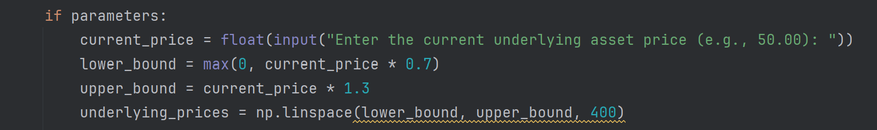
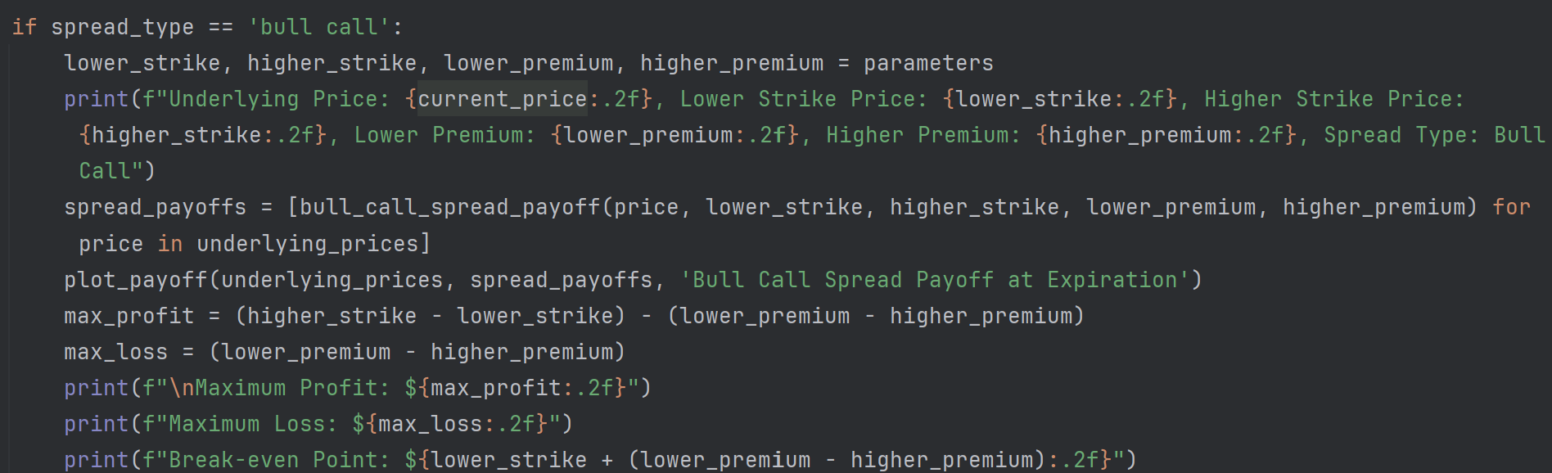
Code for Vertical Spread
Payoff Tool Presentation
Generate Price Range
Prompts user for current price of the asset.
Calculates the price range (70% to 130% of the current price).
Generates 400 price points within that range using NumPy’s linspace.
Spread Payoff Calculations
Calculates and displays option parameters based on the selected spread type.
Computes payoff for each underlying price and generates a payoff plot.
Displays maximum profit, loss, and break-even point.

Slide 19
Limitations & Improvements
Payoff Tool Presentation
Description
Purpose of the Model
Illustrates possible outcomes, not intended to be used as a predictive tool
Aimed to help understand rather than forecast market behavior
Visualizations and Modeling
Effectively visualized potential profits based on price changes in the underlying security
Helped understand the return in correlation to the risk
Limitations
Cannot make probability-based predictions
Improvements
The models could be streamlined by consolidating functions and inputs into one code, enabling strategy selection without switching sections and reducing redundancy.

Slide 20
Q&A

Slide 21
Sources
Payoff Tool Presentation
https://www.investopedia.com/terms/c/calloption.asp
https://www.investopedia.com/terms/p/putoption.asp
https://www.investopedia.com/terms/c/coveredcall.asp
https://www.tastylive.com/concepts-strategies/vertical-spread
https://www.investopedia.com/terms/s/straddle.asp
https://www.euronext.com/en/news/what-long-straddle
https://www.pyquantnews.com/topics/options-trading-with-python

